Slide 1
SORTING ALGORITHM VISUALIZER
By Ujjawal Srivastava
CS Branch

Slide 2
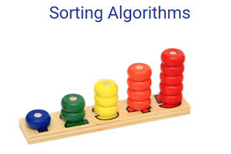
SORTING
In computer science, a sorting algorithm is an algorithm that puts elements of a list in a certain order. The most frequently used orders are numerical order and lexicographical order.
Efficient sorting is important for optimizing the efficiency of other algorithms (such as search and merge algorithms) that require input data to be in sorted lists. Sorting is also often useful for canonicalizing data and for producing human-readable output.

Slide 3
THE PROJECT
Making a GUI Based Application which visualises various Sorting Algorithm
Algorithms to be visualised are:- Bubble Sort, Merge Sort, Quick Sort, Selection Sort, Insertion Sort
Will be using Python and Tkinter Module
The idea is to use bars to represent number whose width will remain constant and height will depend upon the value of the number
It can be used to display the speed of various sorting algorithms

Slide 4
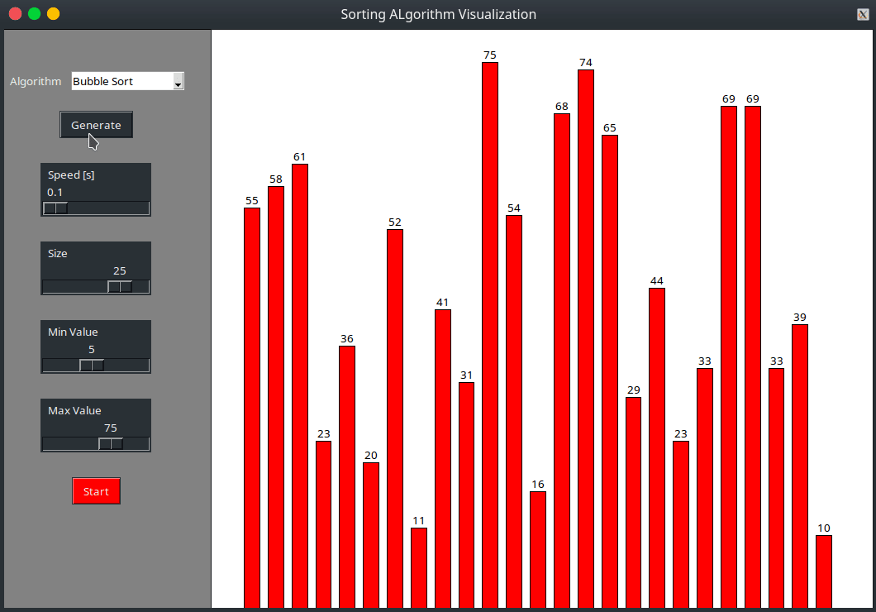
SCREENSHOT FROM PROJECT

Slide 5
COMMON SORTING ALGORITHMS
Bubble Sort - Bubble Sort is the simplest sorting algorithm that works by repeatedly swapping the adjacent elements if they are in wrong order.
Selection Sort - The selection sort algorithm sorts an array by repeatedly finding the minimum element (considering ascending order) from unsorted part and putting it at the beginning.
Insertion Sort - The array is virtually split into a sorted and an unsorted part. Values from the unsorted part are picked and placed at the correct position in the sorted part.
Merge Sort - Merge Sort is a Divide and Conquer algorithm. It divides the input array into two halves, calls itself for the two halves, and then merges the two sorted halves. The merge() function is used for merging two halves.
Quick Sort - QuickSort is a Divide and Conquer algorithm. It picks an element as pivot and partitions the given array around the picked pivot. There are many different versions of quickSort that pick pivot in different ways.

Slide 6
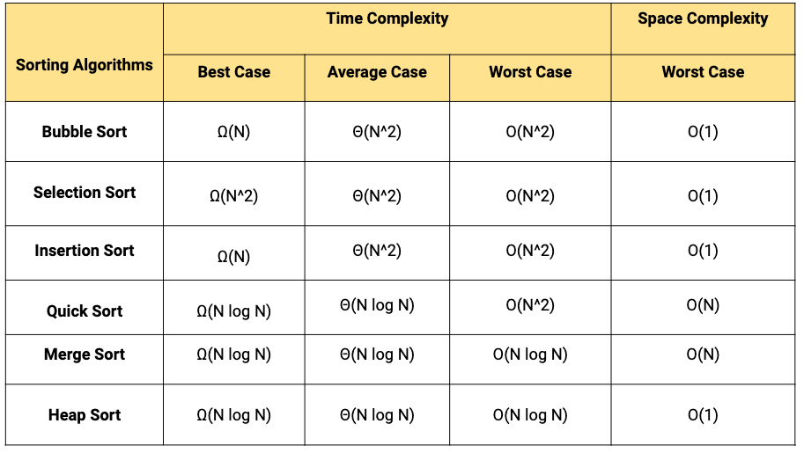
TIME COMPLEXITY

